Slide 1
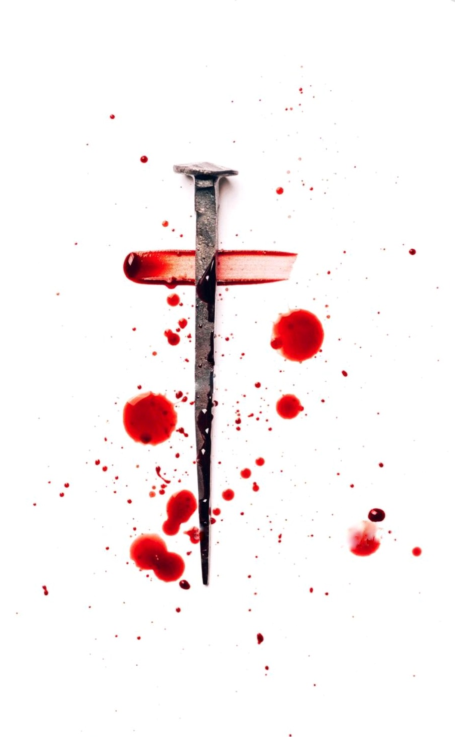
When I Survey the Wondrous Cross
我每思念十字宝架
188

Slide 2
When I survey the wondrous cross
on which the Prince of glory died,
my richest gain I count but loss,
and pour contempt on all my pride.
我每思念十字宝架，
并主如何在上悬挂； 我就不禁浑忘身家，
鄙视从前所有骄傲。

Slide 3
Forbid it, Lord, that I should boast
save in the death of Christ, my God!
All the vain things that charm me most,
I sacrifice them through his blood.
愿主禁我别有所夸，
除了基督的十字架； 前所珍爱虚空荣华，
今为祂血情愿丢下。

Slide 4
See, from his head, his hands, his feet,
sorrow and love flow mingled down.
Did e'er such love and sorrow meet,
or thorns compose so rich a crown?
看从祂头祂脚祂手，
忧情慈爱和血而流； 那有爱忧如此相遘，
荆棘编成如此冕旒？

Slide 5
Were the whole realm of nature mine,
that were a present far too small.
Love so amazing, so divine,
demands my soul, my life, my all.
假若宇宙都归我有，
尽献於主仍觉不够； 爱既如此奇妙深厚，
当得我心我命所有。

Slide 6
Oh… Love so amazing, so divine,
demands my soul, my life, my all
Oh… My ALL！
爱既如此奇妙深厚，
当得我心我命所有。

